Slide 1
Architectural Styles
An architectural style in software consists of a few key features and rules for combining those features so that architectural integrity is preserved. An architectural software style is determined by the following:
set of component types (e.g., data repository, a process, a procedure) that perform some function at runtime
topological layout of these components indicating their runtime interrelationships
set of semantic constraints (for example, a data repository is not allowed to change the values stored in it)
set of connectors (e.g., subroutine call, remote procedure call, data streams, sockets) that mediate communication, coordination, or cooperation among components

Slide 2
Data Centered Architectures
Data-Centered architectures have the goal of achieving the quality of integrability of data.
The term Data-Centered Architectures refers to systems in which the access and update of a widely accessed data store is an apt description.

Slide 3
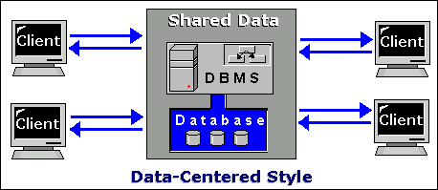
Data Centered Architectures
At its heart, it is nothing more than a centralized data store that communicates with a number of clients.

Slide 4
The means of communication (sometimes called the coordination model) distinguishes the two subtypes: repository (the one shown) and blackboard. A blackboard sends notification to subscribers when data of interest changes, and is thus active.

Slide 5
Repository Architecture Style
In Repository Architecture Style, the data store is passive and the clients (software components or agents) of the data store are active, which control the logic flow. The participating components check the data-store for changes.
The client sends a request to the system to perform actions (e.g. insert data).
The computational processes are independent and triggered by incoming requests.
If the types of transactions in an input stream of transactions trigger selection of processes to execute, then it is traditional database or repository architecture, or passive repository.
This approach is widely used in DBMS, library information system, the interface repository in CORBA, compilers and CASE (computer aided software engineering) environments.

Slide 6
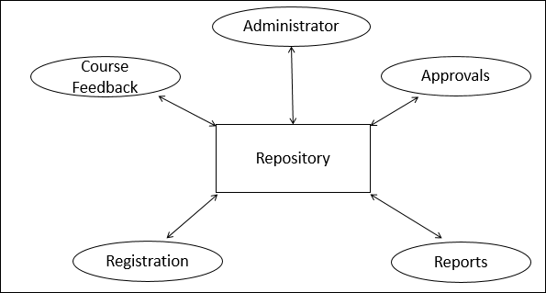

Slide 7
Blackboard Architecture Style
In Blackboard Architecture Style, the data store is active and its clients are passive. Therefore the logical flow is determined by the current data status in data store. It has a blackboard component, acting as a central data repository, and an internal representation is built and acted upon by different computational elements.

Slide 8
Blackboard Architecture Style
Parts of Blackboard Model
The blackboard model is usually presented with three major parts −
Knowledge Sources (KS)
Knowledge Sources, also known as Listeners or Subscribers are distinct and independent units. They solve parts of a problem and aggregate partial results. Interaction among knowledge sources takes place uniquely through the blackboard.
Blackboard Data Structure
The problem-solving state data is organized into an application-dependent hierarchy. Knowledge sources make changes to the blackboard that lead incrementally to a solution to the problem.
Control
Control manages tasks and checks the work state.

Slide 9
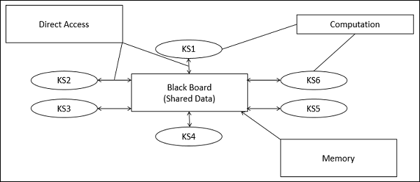
Blackboard Architecture Style

Slide 10
Data Flow Architecture
In data flow architecture, the whole software system is seen as a series of transformations on consecutive pieces or set of input data, where data and operations are independent of each other. In this approach, the data enters into the system and then flows through the modules one at a time until they are assigned to some final destination (output or a data store).
The connections between the components or modules may be implemented as I/O stream, I/O buffers, piped, or other types of connections. The data can be flown in the graph topology with cycles, in a linear structure without cycles, or in a tree type structure.
The main objective of this approach is to achieve the qualities of reuse and modifiability.

Slide 11
Batch Sequential
Batch sequential is a classical data processing model, in which a data transformation subsystem can initiate its process only after its previous subsystem is completely through −
The flow of data carries a batch of data as a whole from one subsystem to another.
The communications between the modules are conducted through temporary intermediate files which can be removed by successive subsystems.
It is applicable for those applications where data is batched, and each subsystem reads related input files and writes output files.
Typical application of this architecture includes business data processing such as banking and utility billing.

Slide 12

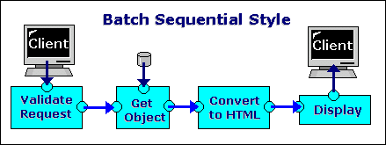
Batch Sequential

Slide 13
Pipe and Filter Architecture
This approach lays emphasis on the incremental transformation of data by successive component. In this approach, the flow of data is driven by data and the whole system is decomposed into components of data source, filters, pipes, and data sinks.
The connections between modules are data stream which is first-in/first-out buffer that can be stream of bytes, characters, or any other type of such kind. The main feature of this architecture is its concurrent and incremented execution.
Filter
A filter is an independent data stream transformer or stream transducers. It transforms the data of the input data stream, processes it, and writes the transformed data stream over a pipe for the next filter to process. It works in an incremental mode, in which it starts working as soon as data arrives through connected pipe.

Slide 14
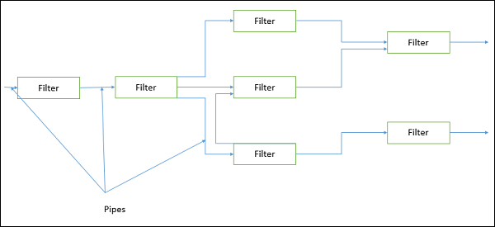
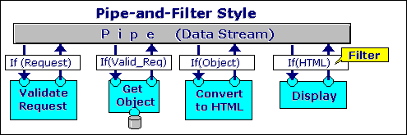
Pipe and Filter Architecture

Slide 15
Virtual Machine Architecture
Virtual Machine architectures have the goal of achieving the quality of portability. Virtual machines are software styles that simulate some functionality that is not native to the hardware and/or software on which it is implemented.

Slide 16
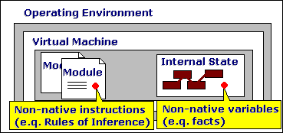
Virtual Machine Architecture

Slide 17
Virtual Machine Architecture
This can be useful in a number of ways:
It can allow one to simulate (and test) platforms that have not yet been built (such as new hardware), and it can simulate "disaster'' modes (as is common in flight simulators and safety-critical systems) that would be too complex, costly, or dangerous to test with the real system.
Common examples of virtual machines are interpreters, rule-based systems, syntactic shells, and command language processors.

Slide 18
Call-and-Return Architectures
call-and-Return architectures have the goal of achieving the qualities of modifiability and solvability.
Call-and-Return architectures have been the dominant architectural style in large software systems for the past 30 years.
However, within this style a number of substyles, each of which has interesting features, have emerged.

Slide 19
Main-Program-and-Subroutine
Main-Program-and-Subroutine architectures is the classical programming paradigm. The goal is to decompose a program into smaller pieces to help achieve modifiability.
A program is decomposed hierarchically. There is typically a single thread of control and each component in the hierarchy gets this control (optionally along with some data) from its parent and passes it along to its children.

Slide 20
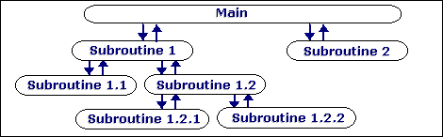
Main-Program-and-Subroutine

Slide 21
Remote procedure call
Remote procedure call systems are main-program-and-subroutine systems that are decomposed into parts that live on computers connected via a network.
The goal is to increase performance by distributing the computations and taking advantage of multiple processors. In remote procedure call systems, the actual assignment of parts to processors is deferred until runtime, meaning that the assignment is easily changed to accommodate performance tuning. In fact, except that subroutine calls may take longer to accomplish if it is invoking a function on a remote machine, a remote procedure call is indistinguishable from standard main program and subroutine systems.

Slide 22
Object-oriented or abstract data type
Object-oriented or abstract data type systems are the modern version of call-and-return architectures.
The object-oriented paradigm, like the abstract data type paradigm from which it evolved, emphasizes the bundling of data and methods to manipulate and access that data (Public Interface).
The object abstractions form components that provide black-box services and other components that request those services. The goal is to achieve the quality of modifiability.

Slide 23
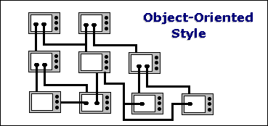
Object-oriented or abstract data type

Slide 24
Layered systems
Layered systems are ones in which components are assigned to layers to control intercomponent interaction. In the pure version of this architecture, each level communicates only with its immediate neighbours.

Slide 25
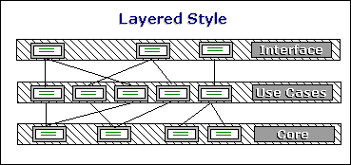
Layered systems

